Slide 1
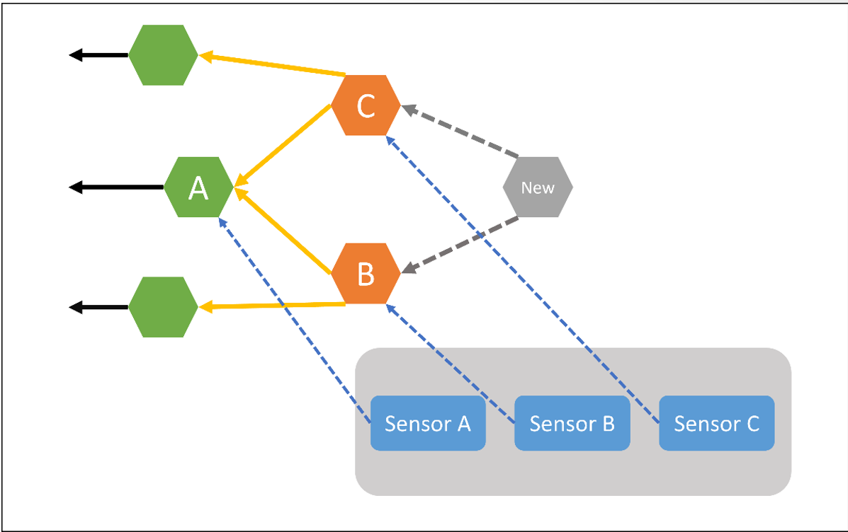
Identify research problem and new idea
Node Trust Model?
WSN, Blockchain, IOTA
Customize the IOTA for WSN
From last term
This term

Slide 2
WSN and IoT
WSN
Sensors
Monitor and record the physical condition of the environment
Collect data
IoT
Physical devices, vehicles, home appliances and other items that embed electronics, software, etc
Connect and exchange data with each other
“IoT is a more complex WSN”
IOTA is for IoT, but not exactly for WSN

Slide 3
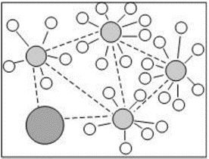
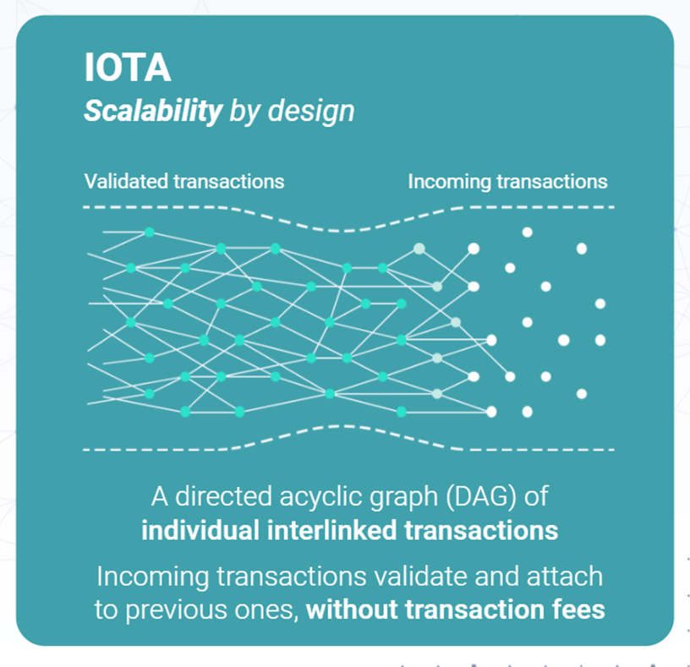
Modify/simplify IOTA to make it suitable for WSN
Well-organized, stable network
complex, unclear structure
Nack, F. (2010). An overview on wireless sensor networks. Institute of Computer Science (ICS), Freie Universität Berlin, 6.
https://wiki.iota.org/learn/about-iota/an-introduction-to-iota

Slide 4
3 sensors
5 sensors
More …

Slide 5
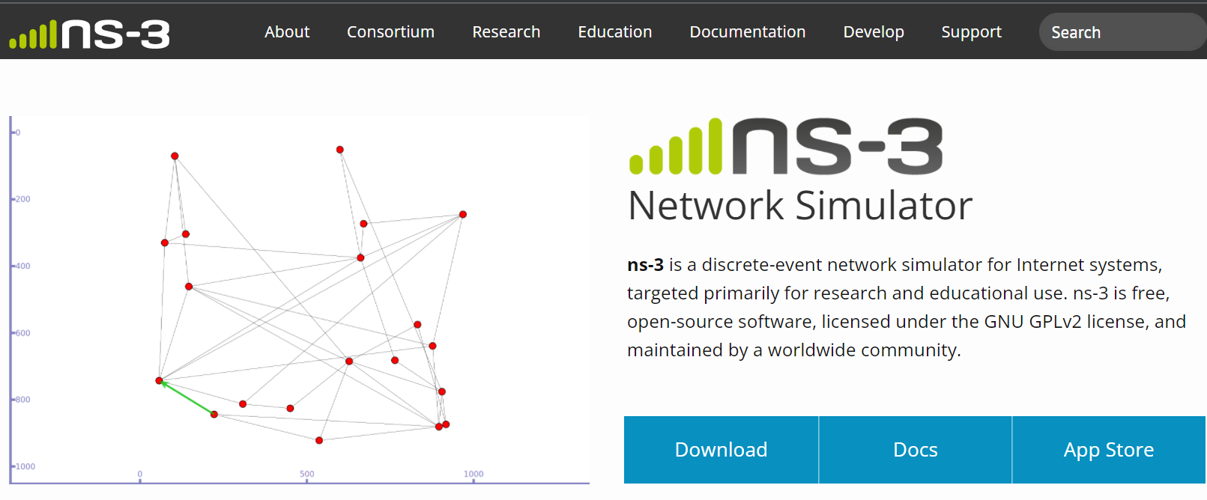
Implementation
Simulate WSN
Write programs to simulate IOTA, and my new structure
Test the performance…
https://www.nsnam.org/

